Slide 1
基于容器的分布式系统的设计模式
“upward”方向，容器可以暴露一套丰富的应用程序信息，包括应用专用监控参数（QPS，应用程序健康等等），用户感兴趣的信息（threads，stack，lock contention，network，message statistics等等），组件配置信息和组件日志。一个具体例子就是，Kubernetes，Aurora，Marathon和其它容器管理系统允许用户通过特定的HTTP端点（比如，”/health”）来定义健康检查。对于之前说过的“upword”API的其它元素的标准化支持就更少了。
“downward”方向，容器接口提供一个地方来定义生命周期，使得写管理系统控制的软件组件更加容易。比如，集群管理系统通常会将“priorities”归到任务中，即使集群订阅超额，高优先级的任务也会保证运行。这个保证通过杀死已经在运行的低优先级的任务来完成，低优先级的任务要等到资源可用的时候才会再继续完成。
https://segmentfault.com/a/1190000005993824

Slide 2
Reinforcement Learning
Huichao Zhao

Slide 3
Problem：
Consider only one single stream ;
Assume that the system knows the amount of resources to allocate to each task;
Object:
Online learning and energy-efficient
Multiple streams on many core systems with resource constraints
Method:
Formalize the problem of multi-stream scheduling as a staged decision problem
A novel class of online adaptive learning techniques which we refer to as staged multi-armed bandits (S-MAB)
Outcome of each scheduling action depends on a sequence of previous scheduling decisions and feedbacks that are taken at a certain stage (window) of time.
Conclusion:
The proposed scheduler, applied on a face detection streaming application
Achieve similar performance compared to an optimal semi-online solution that has full knowledge of the input stream

Slide 4
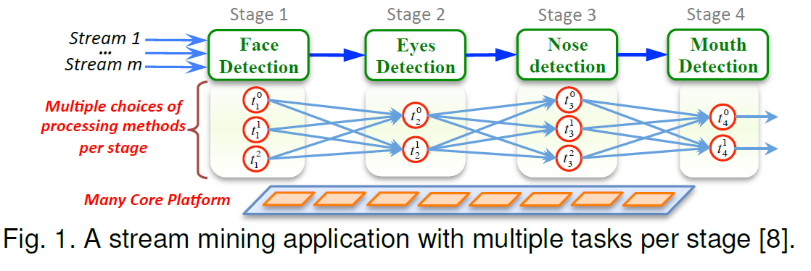
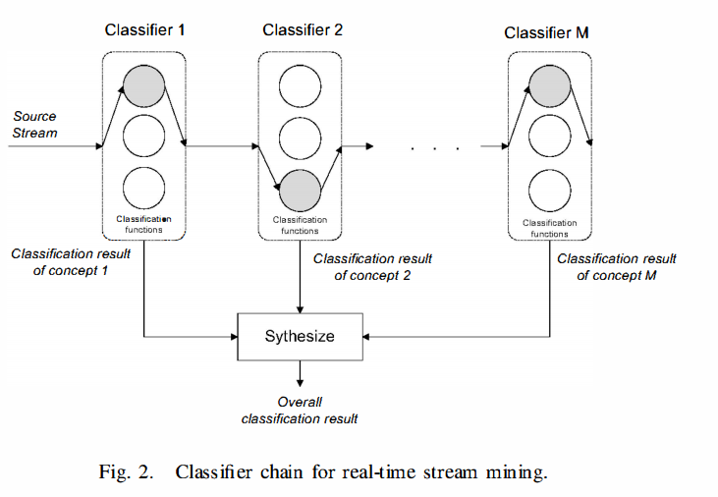
[8] http://medianetlab.ee.ucla.edu/papers/XuTekin_Allerton2013.pdf

Slide 5
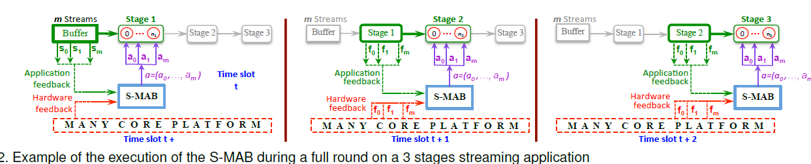
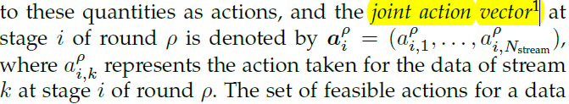
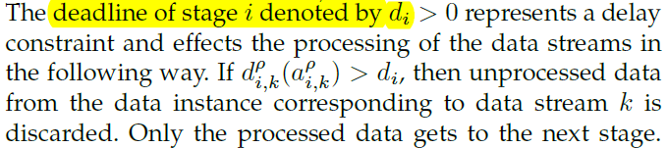
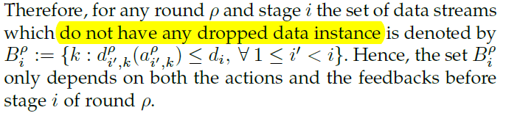
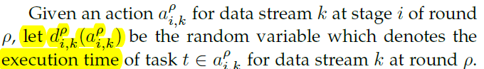
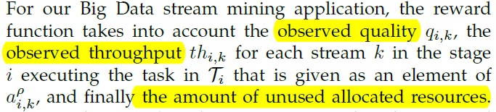
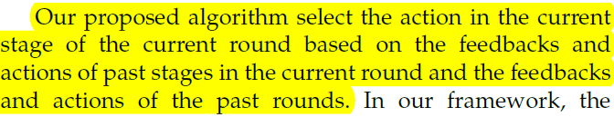

Slide 6
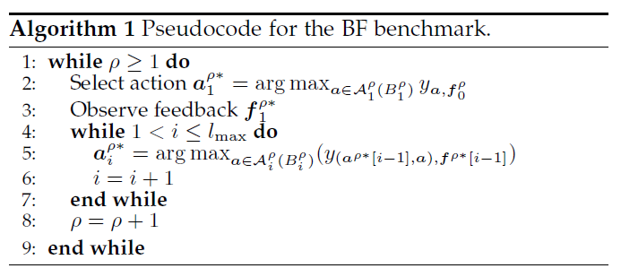
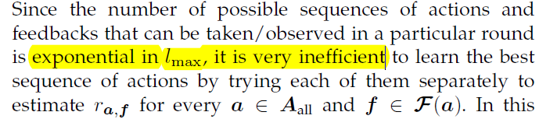
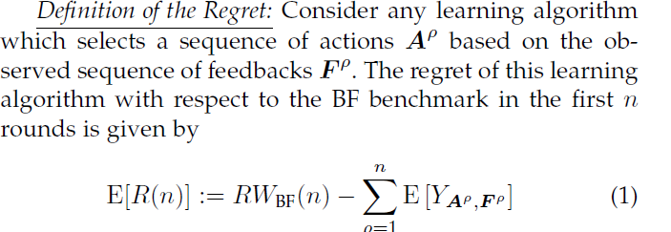
The BF benchmark incrementally selects the next action based on the sequence of feedbacks observed for the actions of the previous stages.

Slide 7
How imporve
The key idea is to have a database that stores all observed feedbacks for each stage and an action space that is built online and customized for each feedback and assigned to it all along the execution.

Slide 8
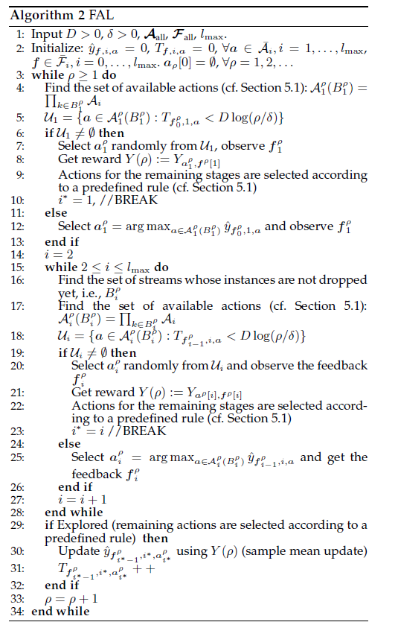
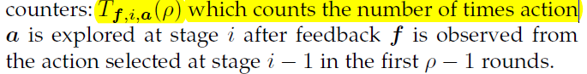
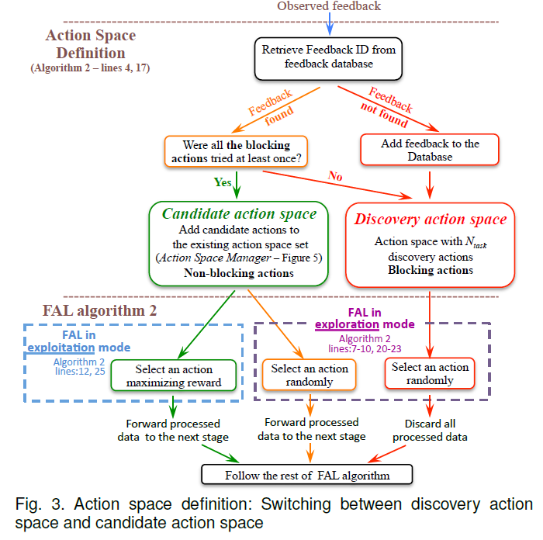

Slide 9
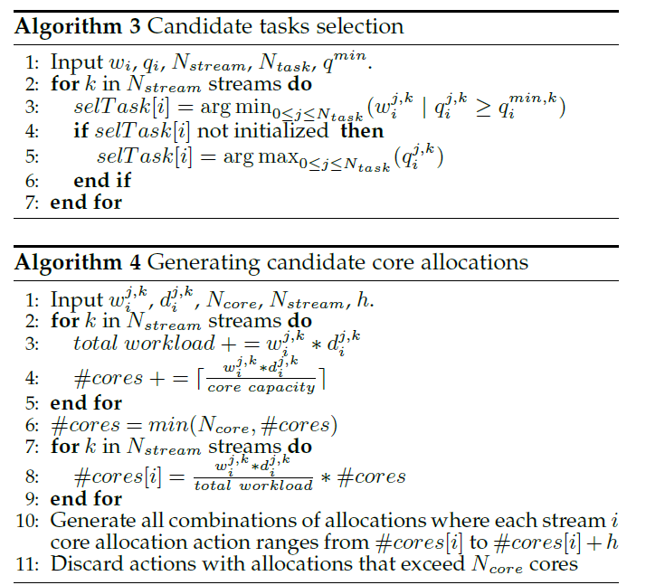
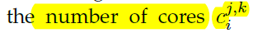
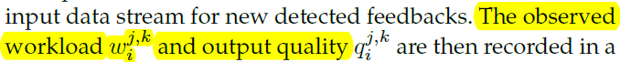
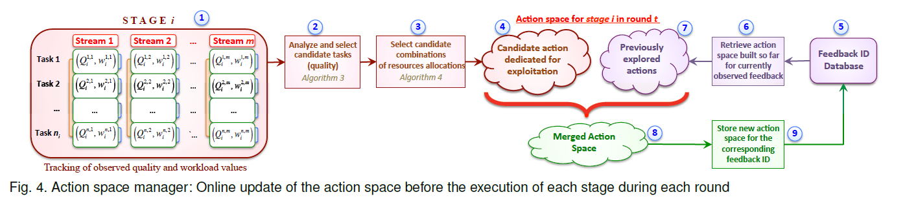

Slide 10
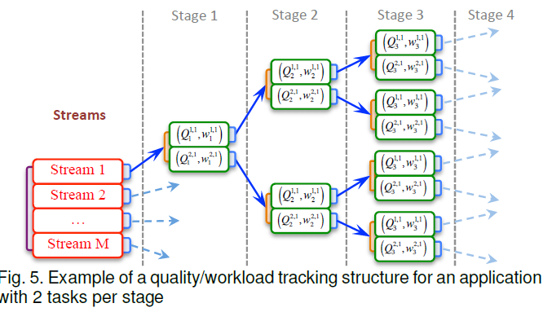

Slide 11
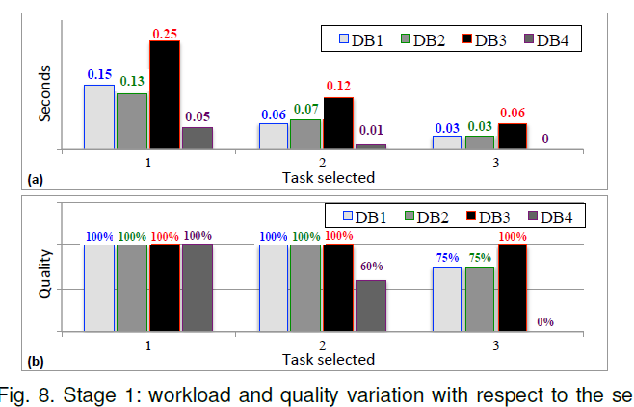
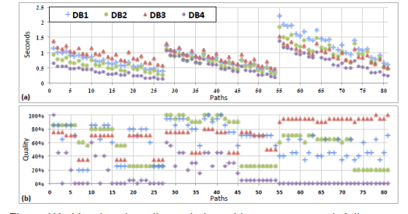
An efficient processing of DB1, DB2, DB3 and DB4 would require their execution with tasks 2, 2, 3 and 1 respectively at stage 1

Slide 12
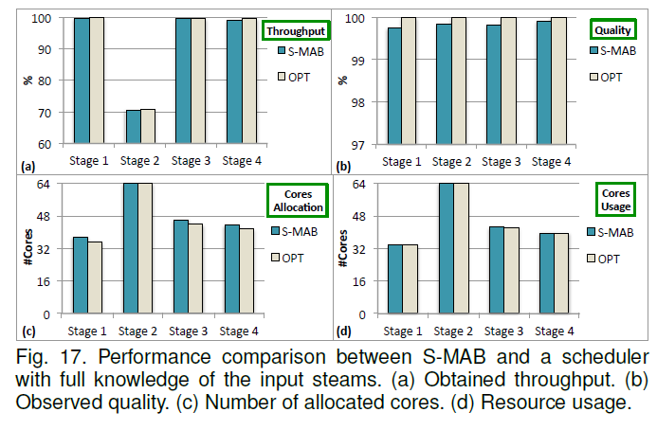
(1) We formalized the problem of multi-streams scheduling as a staged decision problem in which the performance obtained for various resource allocations is unknown a priori but learned over time.
(2) Our scheduler is able to determine which processing method to assign to each stream and how to allocate resources over time in order to maximize the performance on the fly, at run-time, without having access to any offline information.
(3) Unlike other online learning methods such as standard multi-armed bandits and reinforcement learning, in our formulation the outcome of each scheduling action depends on a sequence of previous scheduling decisions and feedbacks that are taken at a certain stage (window) of time.

Slide 13
Using Reinforcement Learning for Autonomic Resource Allocation in Clouds: Towards a Fully Automated Workflow : 2011
A Unified Reinforcement Learning Approach for Autonomic Cloud Managemen：2009
A Hybrid Reinforcement Learning Approach to Autonomic Resource Allocation : 2006

Slide 14
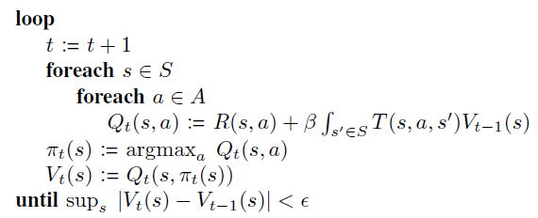
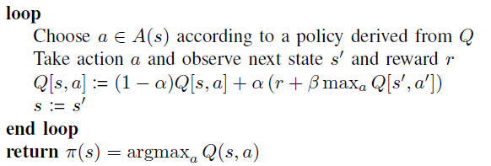
When the functions T and R can be determined prior to the execution of the controlled system, traditional dynamic programming (DP) algorithms, such as value iteration [2][8] can be applied to find an optimal policy
The advantage of traditional DP algorithms is that policies are computed offline. The decision-making at runtime then simply amounts to applying the precomputed policy to the sequence of observed states to provide the corresponding actions.
However, T and R are often very difficult to estimate. This can require lengthy experimentation and measurement processes upon the actual controlled system and it must be redone each time a modification to the system may change the probability distributions of its transitions or rewards.
Using Reinforcement Learning for Autonomic Resource Allocation in Clouds: Towards a Fully Automated Workflow : 2011

Slide 15
A Hybrid Reinforcement Learning Approach to Autonomic Resource Allocation
Gerry Tesauro and Rajarshi Das
IBM TJ Watson Research Center
(To appear, Proc. of ICAC-2006)

Slide 16
Outline: Main points of the talk
Problem Description
Scenario: Online server allocation in Internet Data Center
Data Center Prototype Implementation
Reinforcement Learning Approach
Quick RL Overview
Prior Online RL Approach
New Hybrid RL Approach
Results
Insights into Hybrid RL outperformance
Wrapup

Slide 17
Application: Allocating Server Resources in a Data Center
Scenario: Data center serving multiple customers, each running high-volume web apps with independent time-varying workloads
Data Center
Maximize business value across all customers
Resource
Arbiter
Application
Manager
Application
Manager
Application
Manager
SLA $$
SLA $$
SLA $$
Servers
Servers
Servers
Router
Servers
Router
Servers
Router
Servers
Servers
Servers
Servers
DB2
DB2
DB2
Macy’s Online Shopping
E-Trade: online trading
Citibank: online banking
Notes:
An important challenge: current allocation decision affects future states and future payments

Slide 18
Outline: Main points of the talk
Problem Description
Scenario: Online server allocation in Internet Data Center
Data Center Prototype Implementation:
Real servers: Linux cluster (X series machines)
Realistic Web-based workload: Trade3 (online trading emulation)
Runs on top of WebSphere and DB2
Realistic time-varying demand generation:
Open-loop scenario: Poisson HTTP requests; mean arrival rate  varies with time
Closed-loop scenario: Finite number of customers M with fixed mean think time; M varies with time
Use Squillante-Yao-Zhang time-series model to vary M or  above

Slide 19
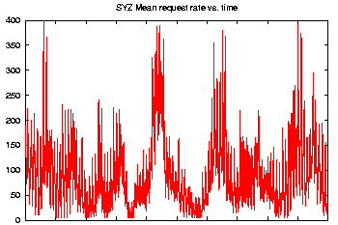
Data Center Prototype: Experimental setup
Demand
(HTTP req/sec)
Maximize Total SLA Revenue
Demand
(HTTP req/sec)
5 sec
Resource
Arbiter
Value(#srvrs)
Value(#srvrs)
Value(#srvrs)
App
Manager
App
Manager
App
Manager
SLA
SLA
SLA
Value(RT)
WebSphere 5.1
Value(#srvrs)
WebSphere 5.1
Value(RT)
Trade3
DB2
Batch
DB2
Trade3
Server
Server
Server
Server
Server
Server
Server
Server
8 xSeries servers
Notes:
WebSphere and DB2 installed on each server machine

Slide 20
Standard Approach: Queuing Models
Design an appropriate model of flows/queues in system
Estimate model parameters offline or online
Model estimates Value(numServers) by estimating (asymptotic) performance changes due to changes in numServers
Has worked well in deployed systems
Two main limitations:
Model design is difficult and knowledge-intensive
Model assumptions don’t exactly match real system
Real systems have complex dynamics; standard models assume steady-state behavior
Two prospective benefits of machine learning approach:
Avoid knowledge bottleneck
Decisions can reflect dynamic consequences of actions
e.g. properly handle transients and switching delays

Slide 21
Outline: Main points of the talk
Problem Description
Reinforcement Learning Approach
Quick RL Overview
Results
Insights into Hybrid RL outperformance
Wrapup

Slide 22
Reinforcement Learning (RL) approach
System
App 1
Value(RT)
Monitored data streams
# servers
Reward
State
Action
RL
Alg?

Slide 23
Reinforcement Learning: 1-slide Tutorial
A learning agent interacts with the environment
Observes current state s of the environment
Takes an action a
Receives an (immediate) scalar reward r
Agent learns a long-range value function V(s,a)
estimating cumulative future reward:
We use a standard RL algorithm “Sarsa”: learns state-action value function
By design RL does “trial-and-error” learning without model of environment
Naturally handles long-range dynamic consequences of actions (e.g., transients, switching delays)
Solid theoretical grounding for MDPs; recent practical success stories
State
System
Reward
Action
Agent

Slide 24
Outline: Main points of the talk
Problem Description
Reinforcement Learning Approach
Quick RL Overview
Online RL Approach
Results
Insights into Hybrid RL outperformance
Wrapup

Slide 25
Online RL in Trade3 Application Manager (AAAI 2005)
Resource
Arbiter
Observed state = current demand  only
Arbiter action = # servers provided (n)
Instantaneous reward U = SLA payment
Learns long-range expected value function V(state,action) = V(, n)
(two-dimensional lookup table)
Data Center results:
good asymptotic performance, but
poor performance during long training period
method scales poorly with state space size
Servers
V(n)
SLA (RT)
TRADE3 App Mgr
U
Response
Time
RL
V(, n)
Demand 
Server
Server
Server
Application Environment

Slide 26
Outline: Main points of the talk
Problem Description
Reinforcement Learning Approach
Quick RL Overview
Online RL Approach
Hybrid RL Approach
Results
Insights into Hybrid RL outperformance
Wrapup

Slide 27
Three innovations since AAAI-05
1. “Delay-Aware” State Representation:
Include previous allocation decision as part of current state  V = V( _{t} , n_{t-1} , n_{t} )
Can learn to properly evaluate switching delay (provided that delay < allocation interval)
e.g. can distinguish V(, 2, 3) from V(, 3, 3)
delay need not be directly observable: RL only observes delayed reward
Also handles transient suboptimal performance
2. Nonlinear Function Approximation (Neural Nets)
Generalizes across states and actions
Obviates visiting every state in space
Greatly reduces need for “exploratory” actions
Much better scaling to larger state spaces
From 2-3 state variables to 20-30, potentially
But: lose convergence guarantees

Slide 28
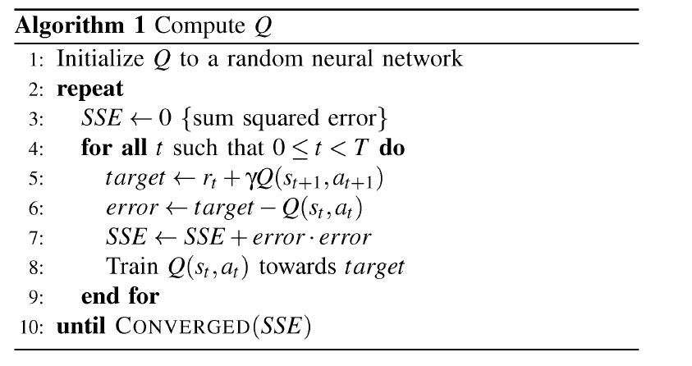

Three innovations since AAAI-05
In Unity prototype system
Implement best queuing models within each Trade3 mgr
Log system data in overnight run (~12-20 hrs)
Train RL on log data (~2 cpu hrs)  new value functions
Replace queuing models by RL value functions and rerun experiment
3. Hybrid Reinforcement Learning
Bellman Policy Improvement Theorem (1957)
Combines best aspects of both RL and model-based (e.g. queuing) methods
Very general method that automatically improves any existing systems management policy
State
System
RL
RL
Reward
Action
RL
MBP

Slide 29
Outline: Main points of the talk
Problem Description
Reinforcement Learning Approach
Results
Insights into Hybrid RL outperformance
Wrapup

Slide 30
Outline: Main points of the talk
Problem Description
Reinforcement Learning Approach
Results
Insights into Hybrid RL outperformance
Wrapup

Slide 31
Insights into Hybrid RL outperformance
1. Less biased estimation errors
Queuing model predicts indirectly: RT  SLA(RT)  V
Nonlinear SLA induces overprovisioning bias
RL estimates utility directly  less biased estimate of V
2. RL handles transients and switching delays
Steady-state queuing models cannot
3. RL learns to avoid thrashing

Slide 32
Hybrid RL does less swapping than QM
0.9
0.8
0.736
0.7
0.654
0.6
0.578
0.581
0.5
0.464
0.486
<n>
0.4
0.269
0.331
0.3
0.2
0.1
0
QM
RL
QM
RL
QM
RL
QM
RL
Delay=0
Delay=4.5
Delay=0
Delay=4.5
Open
Open
Closed
Closed
Experiment

Slide 33
Outline: Main points of the talk
Problem Description
Reinforcement Learning Approach
Results
Insights into Hybrid RL outperformance
Wrapup

Slide 34
Conclusions
Hybrid RL works quite well for server allocation
combines disparate strengths of RL and queuing models
exploits domain knowledge built into queuing model
but doesn’t need access to knowledge: only uses externally observable behavior of queuing model policy
Potential for wide usage of Hybrid RL in systems management
managing other resource types: memory, storage, LPARs etc.
manage control params: web server/OS params etc.
simultaneous management of multiple criteria: performance/utilization, performance/availability etc.
Current work: explore using hybrid RL for resource allocation in WebSphere XD and Tivoli Intelligent Orchestrator

Slide 35
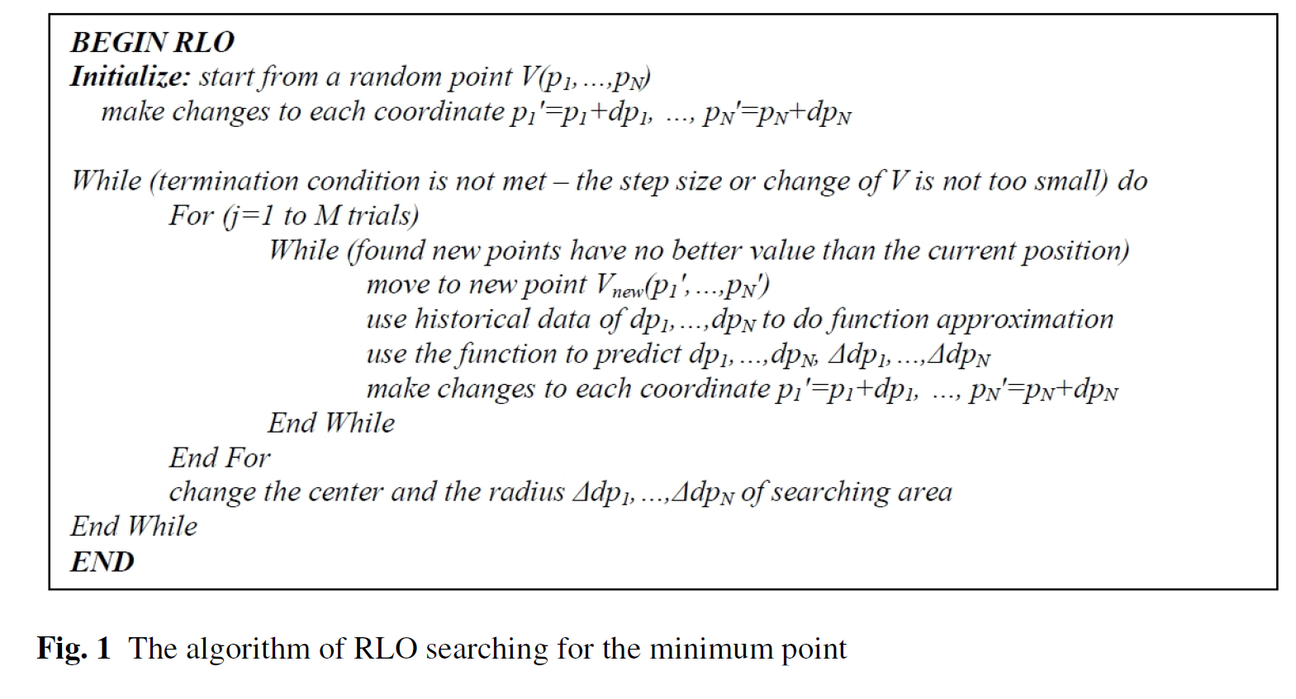
http://citeseerx.ist.psu.edu/viewdoc/download?doi=10.1.1.418.2577&rep=rep1&type=pdf

Slide 36
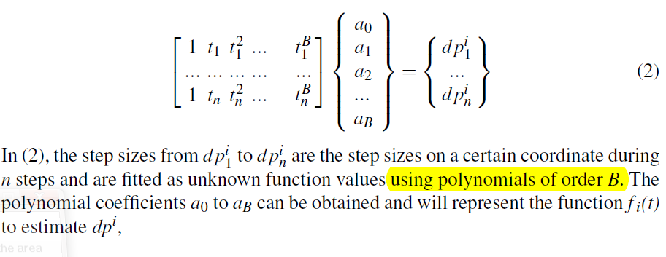
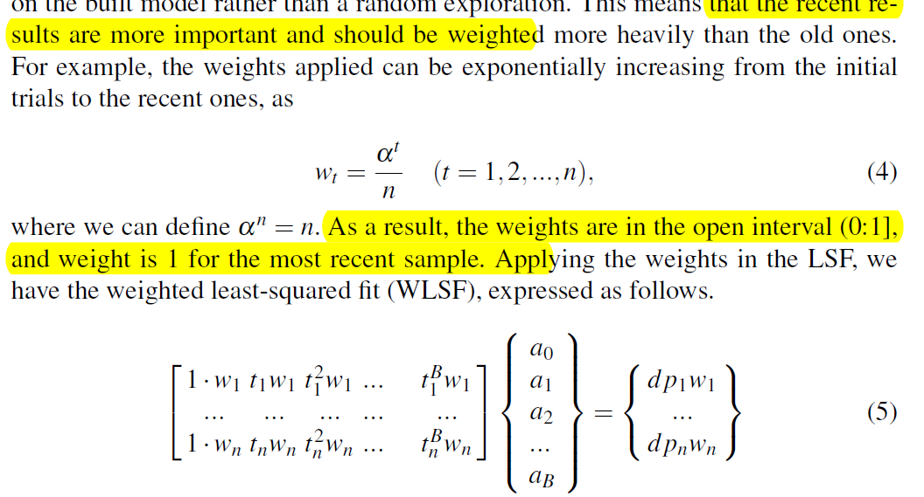
http://citeseerx.ist.psu.edu/viewdoc/download?doi=10.1.1.418.2577&rep=rep1&type=pdf

Slide 37
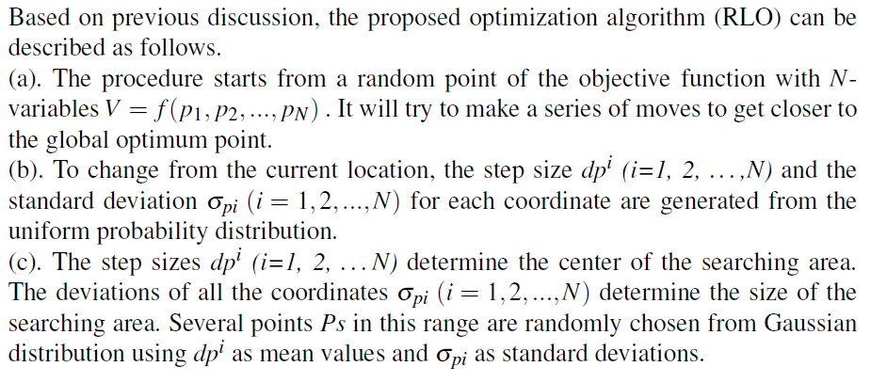
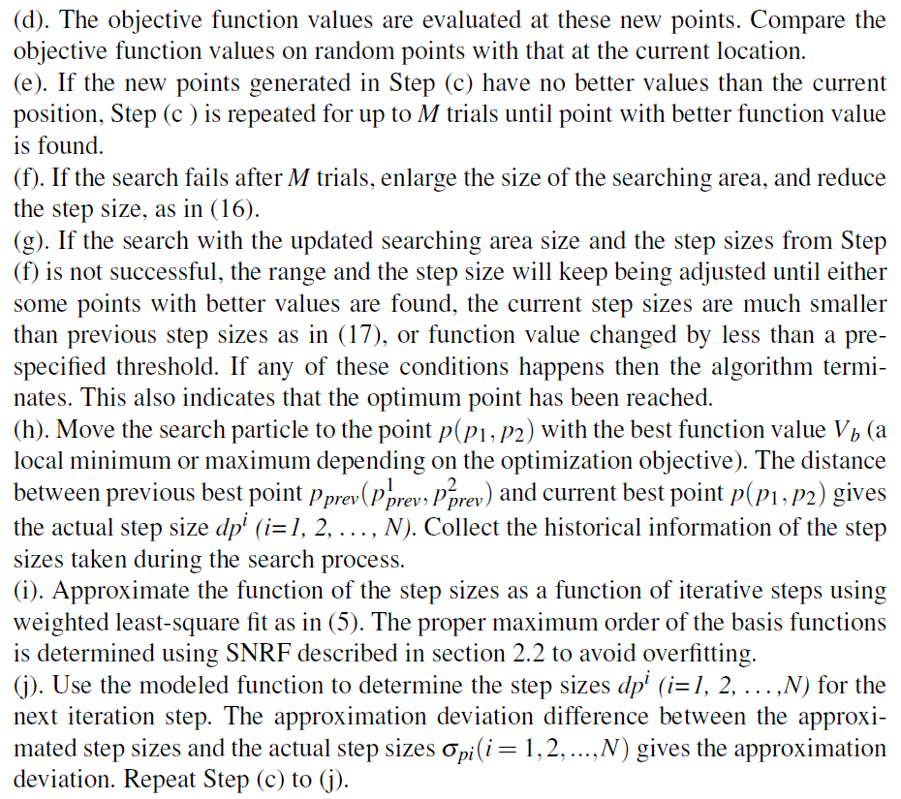
http://citeseerx.ist.psu.edu/viewdoc/download?doi=10.1.1.418.2577&rep=rep1&type=pdf

Slide 38
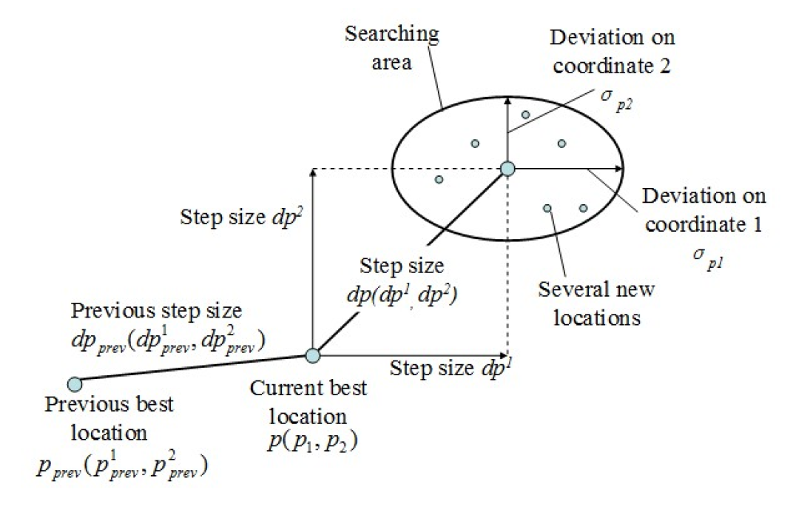
http://citeseerx.ist.psu.edu/viewdoc/download?doi=10.1.1.418.2577&rep=rep1&type=pdf

Slide 39
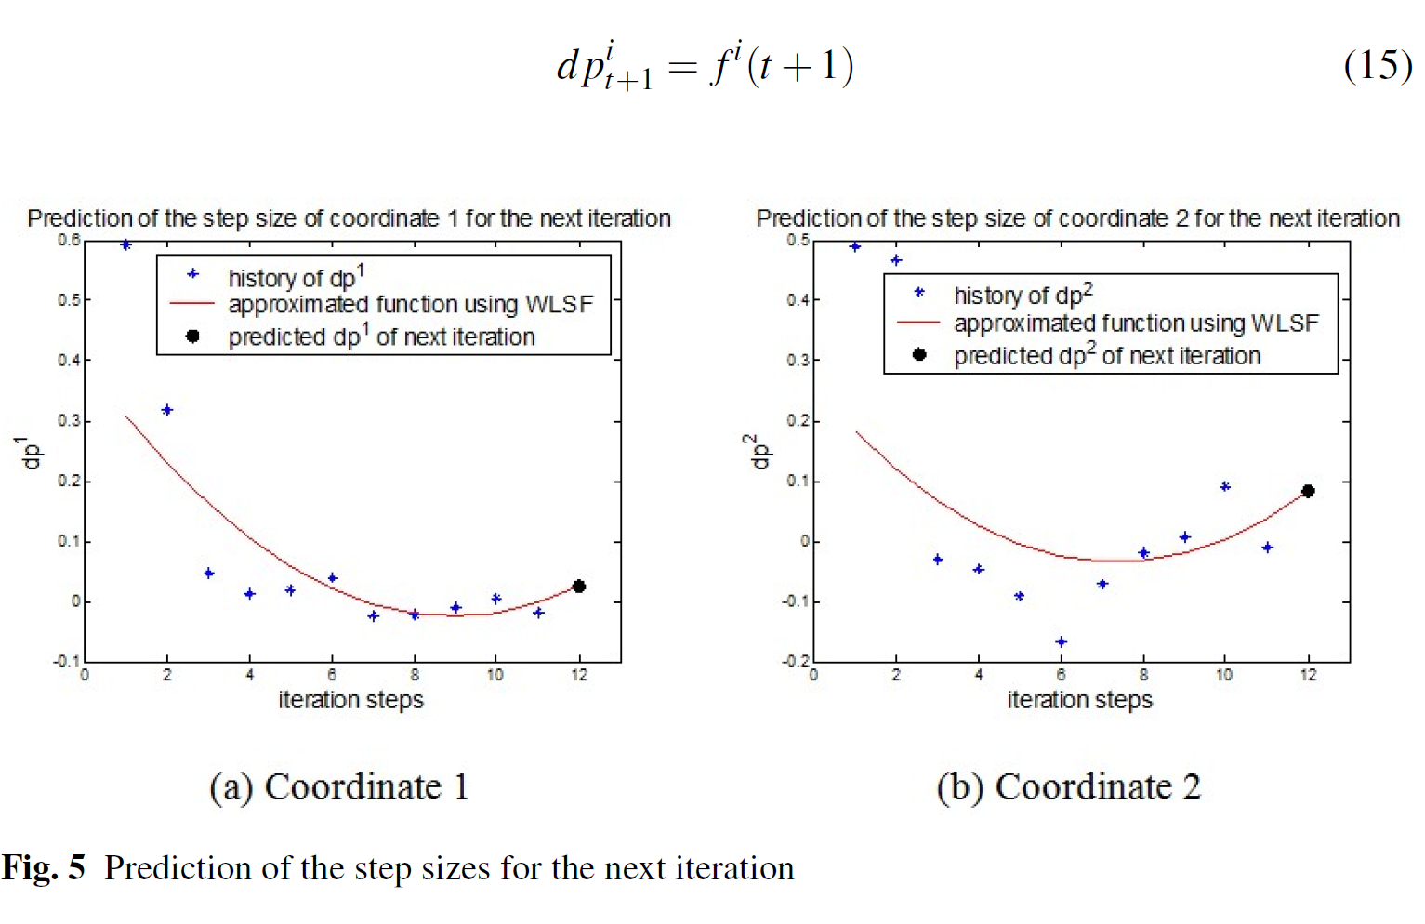
http://citeseerx.ist.psu.edu/viewdoc/download?doi=10.1.1.418.2577&rep=rep1&type=pdf

Slide 40
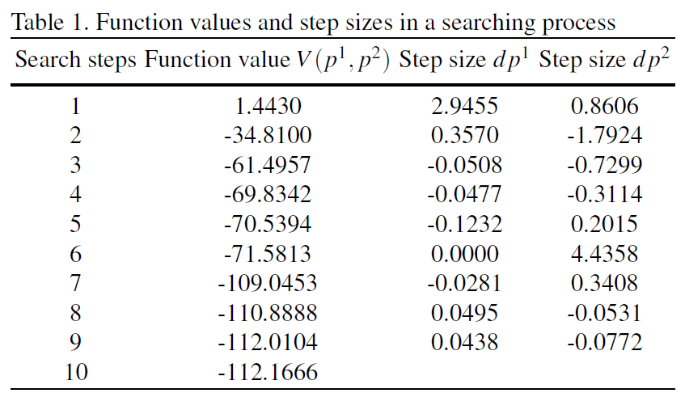
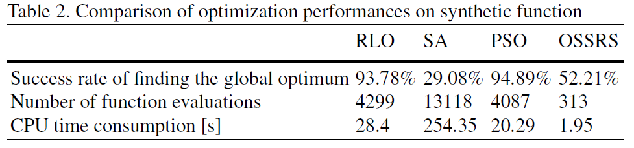
http://citeseerx.ist.psu.edu/viewdoc/download?doi=10.1.1.418.2577&rep=rep1&type=pdf

Slide 43
End

Slide 46
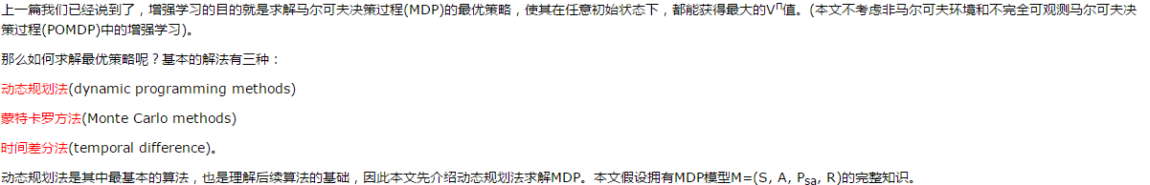
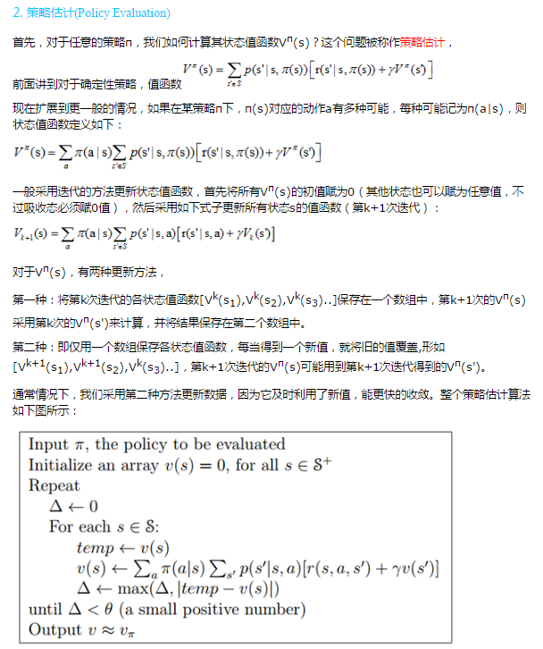
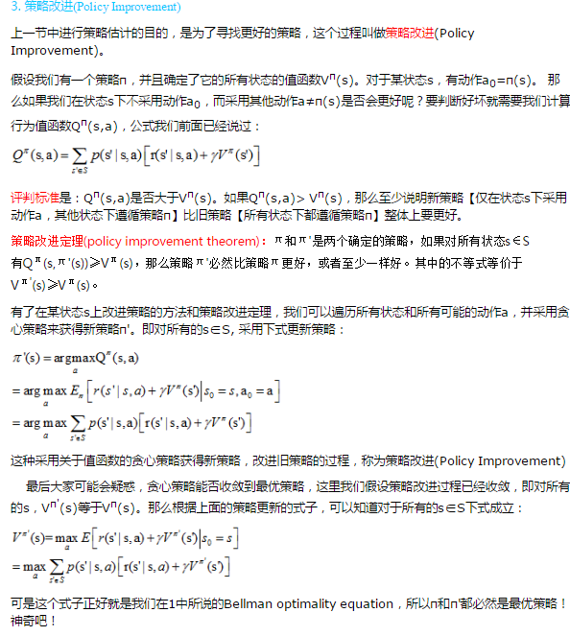
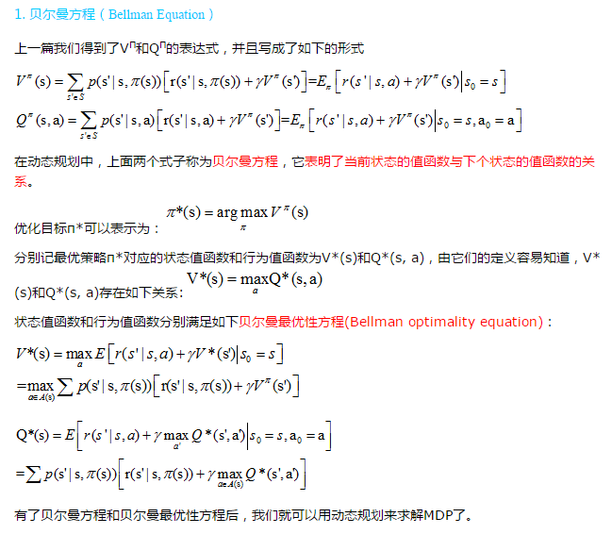

Slide 47
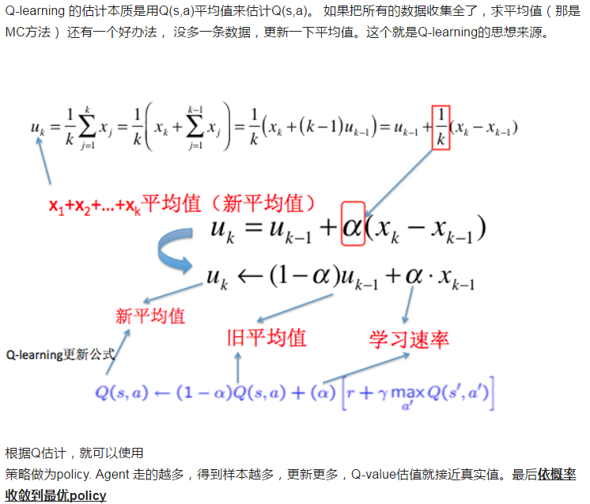

Slide 50
https://www.zhihu.com/question/33711002

Slide 51
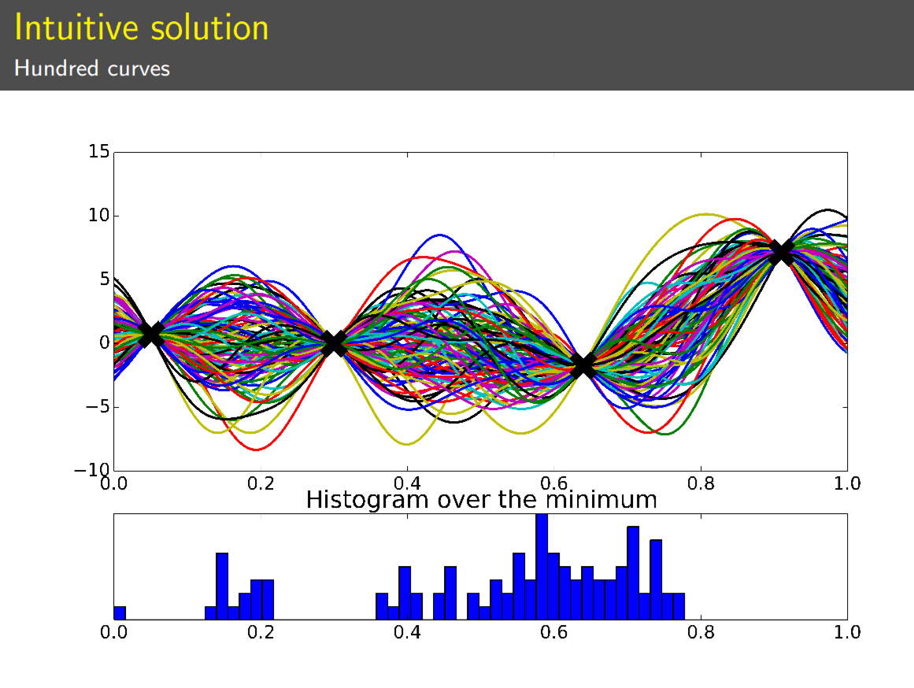
http://gpss.cc/gpss15/talks/gpgo-gpss2015.pdf

Slide 52
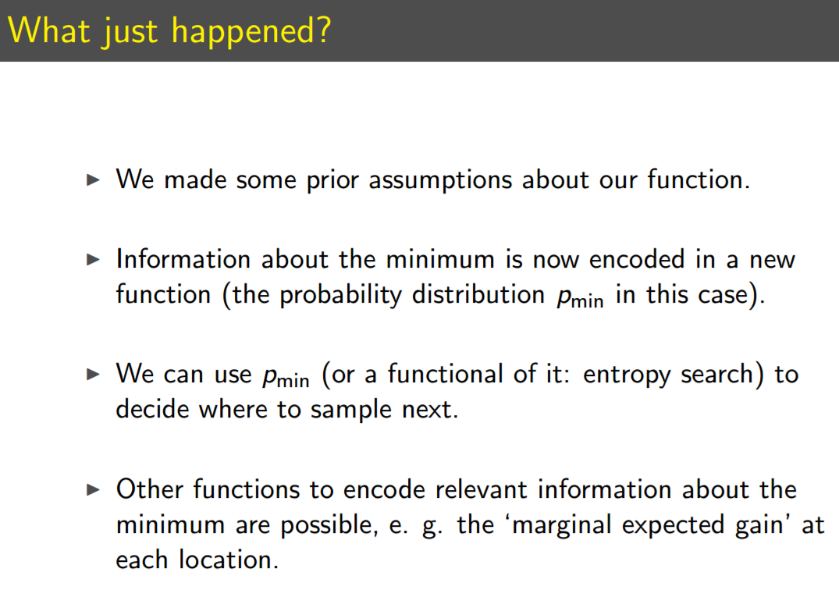
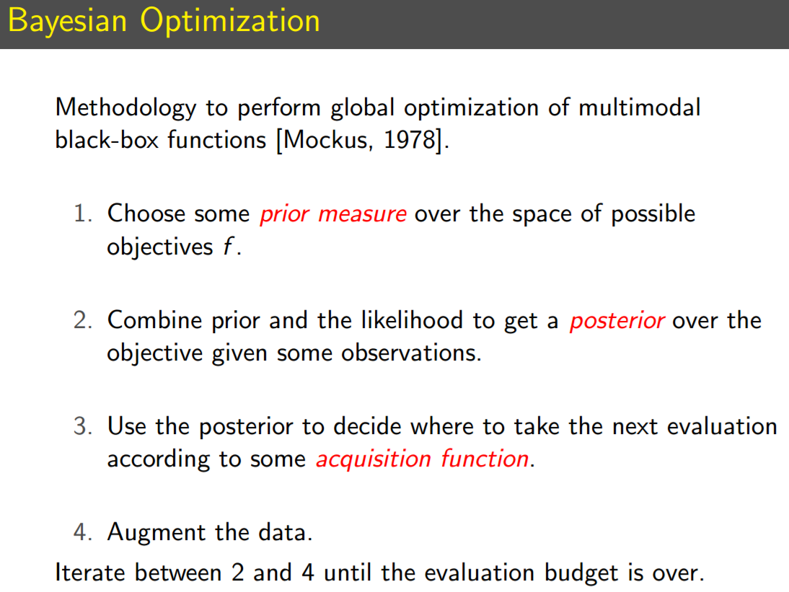
http://gpss.cc/gpss15/talks/gpgo-gpss2015.pdf

Slide 53
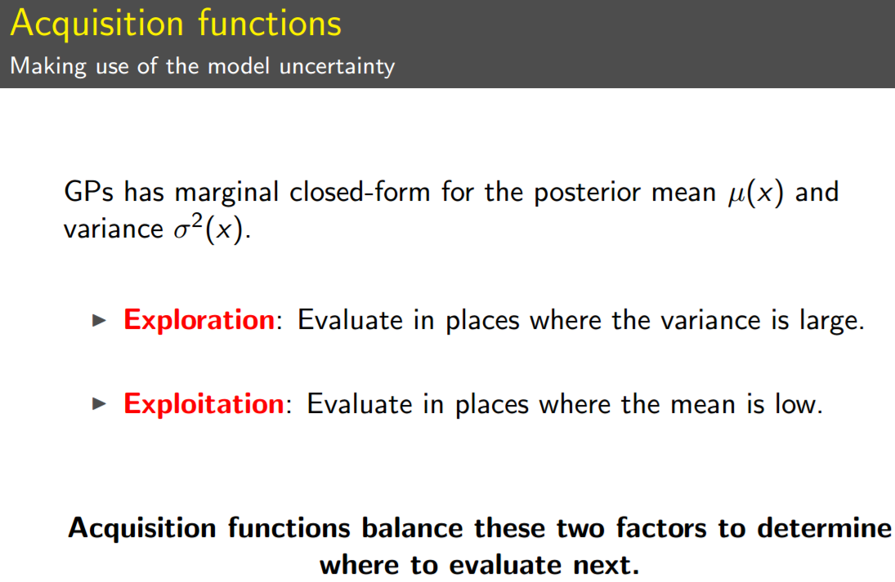
http://gpss.cc/gpss15/talks/gpgo-gpss2015.pdf

Slide 54
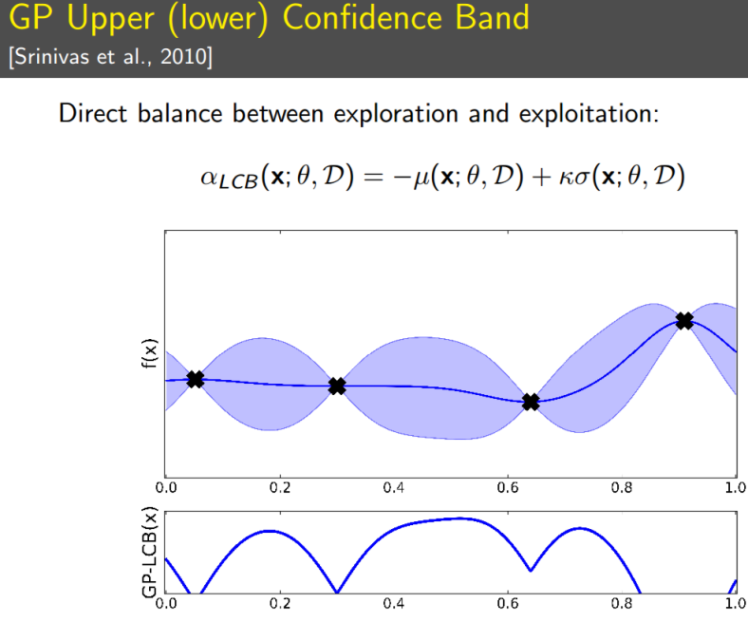
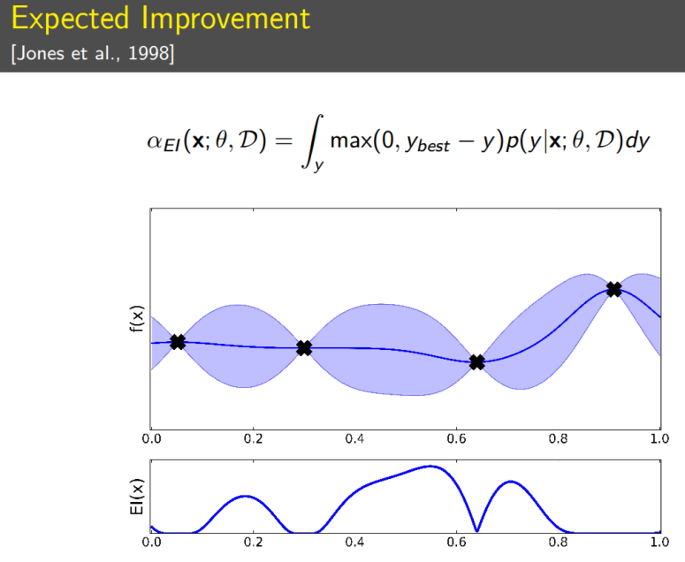
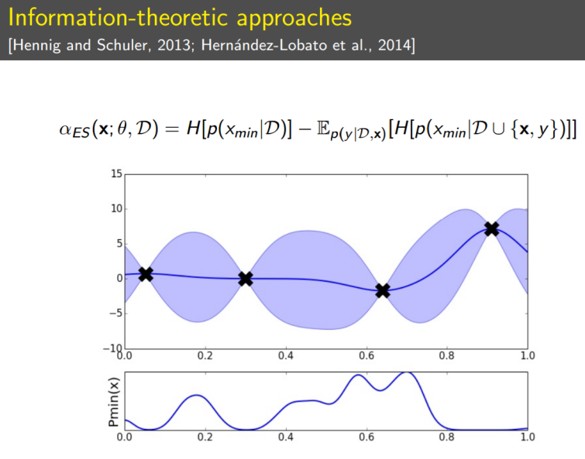
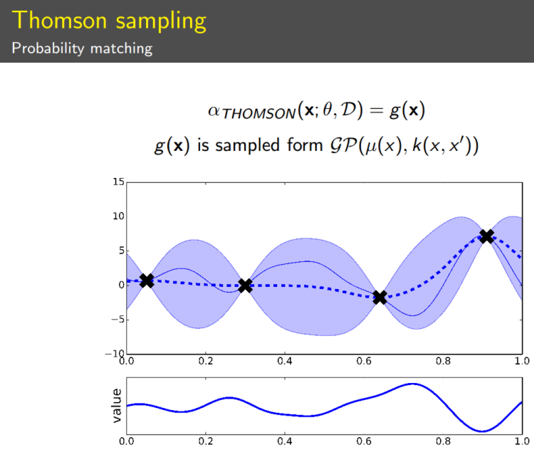
http://gpss.cc/gpss15/talks/gpgo-gpss2015.pdf

Slide 55
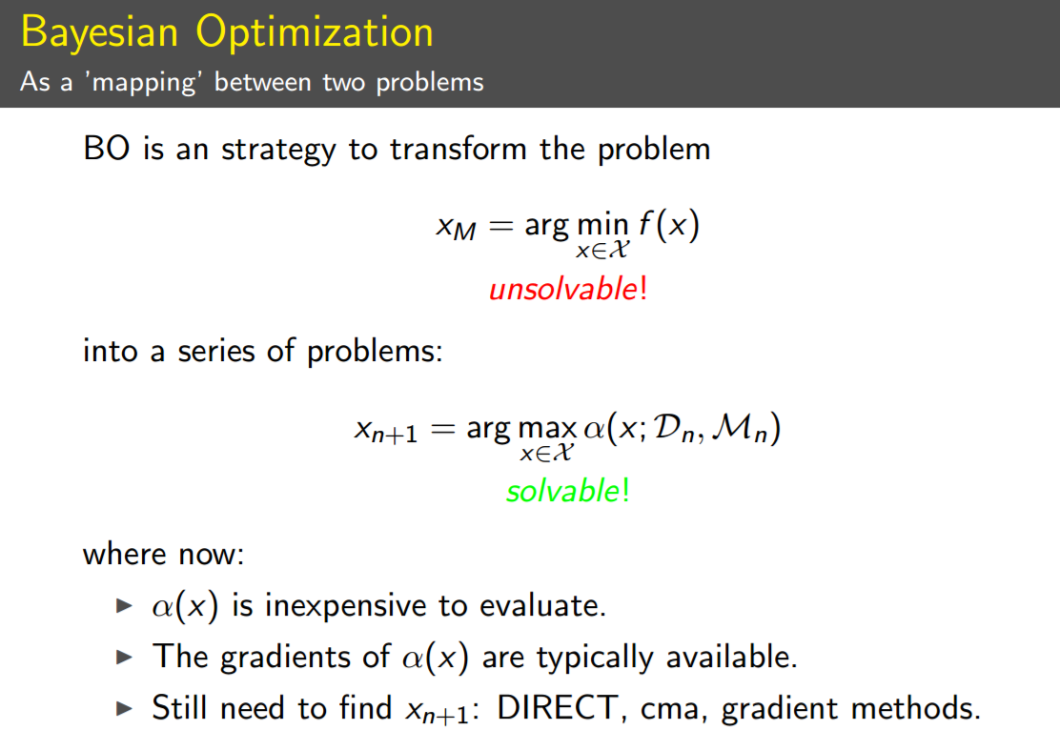



http://gpss.cc/gpss15/talks/gpgo-gpss2015.pdf

Slide 56
http://gpss.cc/gpss15/talks/gpgo-gpss2015.pdf

Slide 57
https://people.orie.cornell.edu/pfrazier/Presentations/2011.11.INFORMS.Tutorial.pdf

Slide 58



Slide 59
http://www.gaussianprocess.org/gpml/

Slide 61



http://www.cnblogs.com/hxsyl/p/5229746.html

Slide 62


http://www.cnblogs.com/hxsyl/p/5229746.html

Slide 63



http://www.cnblogs.com/hxsyl/p/5229746.html

Slide 64

http://www.cnblogs.com/hxsyl/p/5229746.html

Slide 65
http://www.cnblogs.com/hxsyl/p/5229746.html

Slide 66
http://www.cnblogs.com/hxsyl/p/5229746.html

